Slide 1



Blue Ocean Gear
Buoy Location Prediction and Temperature Analysis
Aurora Peng, Brinda Sapra, Hazel Chui, Zoey Jiao
December 9th, 2022

Slide 2
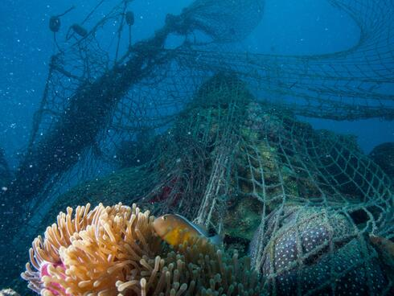
Introduction
Background on BOG
Ghost fishing gear one of the most harmful forms of marine plastic as it catches wildlife, subjecting them to a slow and painful death through exhaustion and suffocation.
Fishing gear accounts for 10% of ocean debris: between 500,000 to 1 million tons of fishing gear are discarded or lost in the ocean every year.
Blue Ocean Gear, founded in California, has developed a smart buoy system that tracks lost fishing gear in the ocean.
Notes:
Zoey
The company is dedicated to preventing lost fishing gear and the subsequent negative impacts of ghost fishing and als improving efficiency for fishers through better data tracking.

Slide 3
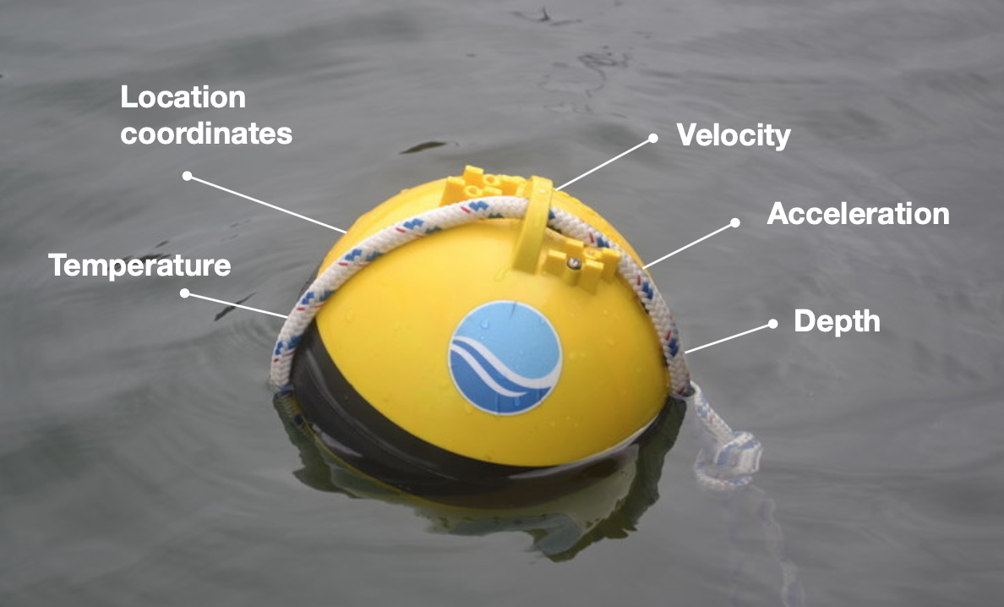
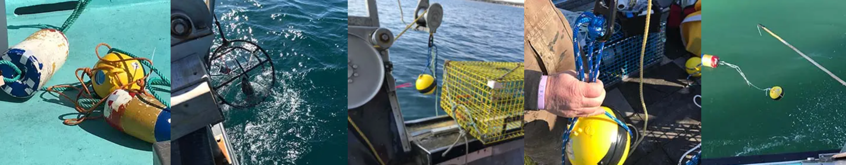
Introduction
How fishermen use BOG Smart Buoys
Trap (hook, pot)
Fishery (Massachusetts, Maine, New Brunswick)
Notes:
Zoey
Commercial vessels catch fish and shellfish using a variety of traps (e.g., hooks, pots). These traps are tied to one or more buoys that float on top of the water, so fishermen can easily track their positions.
Blue Ocean Gear has developed a Farallon Smart Buoy product that is tied to the main buoy and uses sensors to record its GPS coordinates, velocity, acceleration, depth, battery temperature, etc. along with the external water temperature. Fishermen configure their Smart Buoys to transmit data at specific time intervals via satellite or radio. These buoy messages are then stored in a database and made accessible through an API (Applications Programming Interface).
Several of Blue Ocean Gear's customers have been fishing and reporting from the Northwest Atlantic, off the coasts of Massachusetts, Maine, and New Brunswick. The goal of this task is to analyze this data using Jupyter notebooks to uncover patterns of motion and temperature by fishery.

Slide 4
Project Objective
Goal
Create a dashboard allowing users to generate reports of buoy activity in near real-time
Location prediction of drifting buoys to ensure faster recovery of lost gear
Establishing baseline comparisons for buoys’ temperature sensors
Research questions
How do Smart Buoys’ sensor readings compare to readings from external data sources?
Where will a Smart Buoy ‘drift’ in the ocean if its gear breaks free?
Notes:
Zoey

Slide 5
Research Question #1: Temperature Sensor Validation

Slide 6
Temperature Sensor Validation
Motivation:
Accurate temperature readings allow fishermen to fish more efficiently
BOG hopes to validate their sensor readings against third-party datasets to identify any systematic errors/ discrepancies

Slide 7
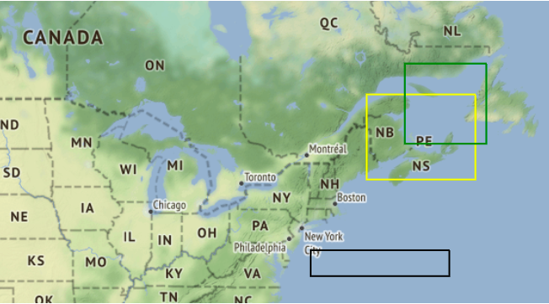
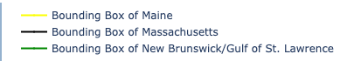
Temperature Sensor Validation
Geographical locations/ fisheries:
 | BOG reading | Copernicus satellites | Canadian weather stations
Range of time | 2021-03-10 to 2022-10-04 | 2022-04-11 to 2022-10-04 | 2022-03-09 to 2022-10-05
Frequency | On average every 1 min to 60 mins | 60 mins | 10 minutes
Notes:
it a free, public satellite data service operated by the European Union
This data was reported every hour at a spatial resolution of 1/12 degrees

Slide 8
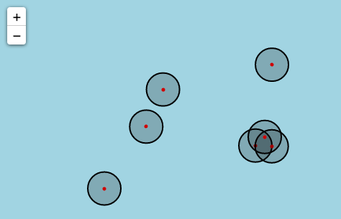
Methodology
Segmenting buoy readings into deployments
Writing scripts to query APIs for sea surface temperatures recorded by Copernicus satellites and Canadian weather stations
Matching deployment readings by:
(a) For the Copernicus satellites:
* Red dots represent buoys
1. Draw buffers around each buoy location
2. Calculate the min, max, and average temperature of the satellite data within the buffers
Notes:
Analyze water temperature differences by deployments and by fishery

Slide 9
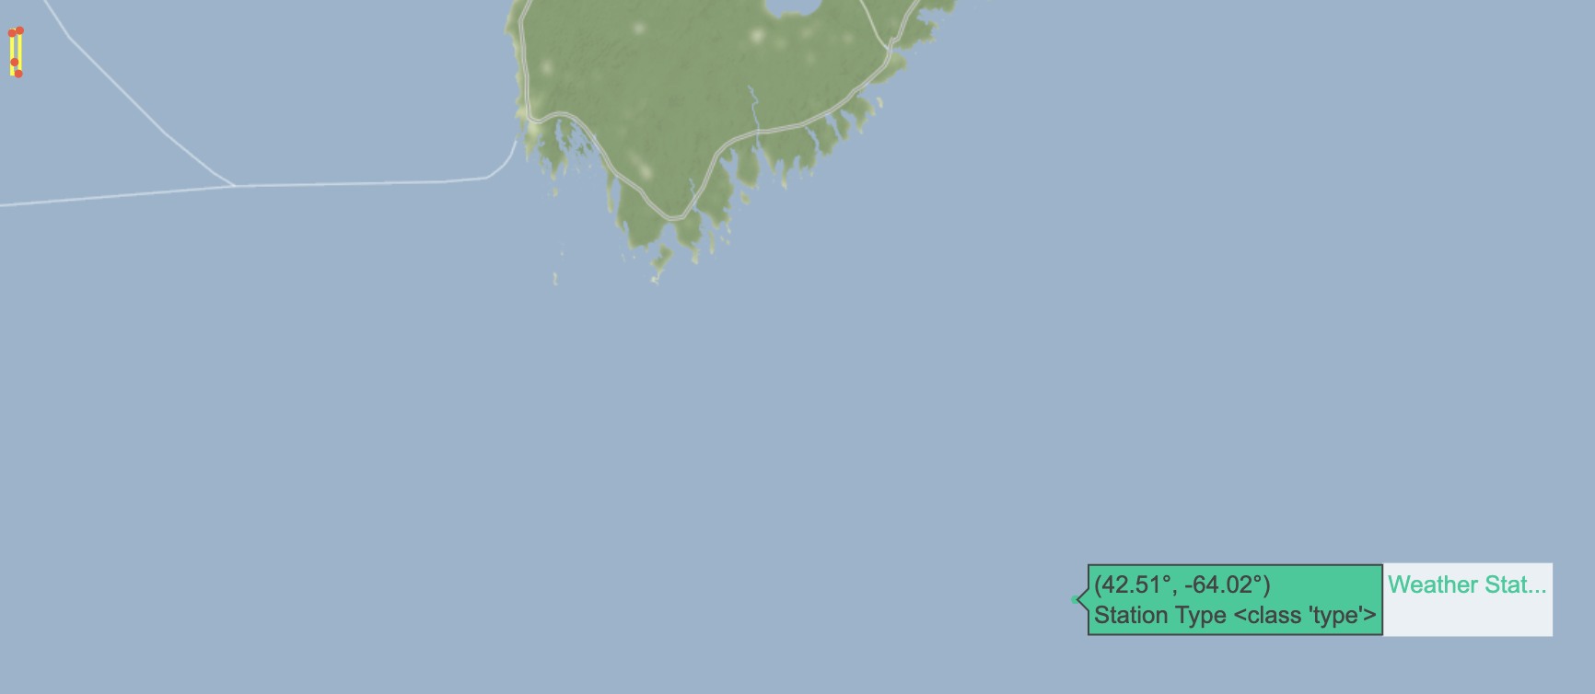
Methodology - Continued
Matching deployment readings by:
(b) For the nearest neighboring Canadian weather station:
Process buoy readings in batches by date
For each buoy reading:
Find nearest station using haversine distance
From nearest station, find reading that occurs closest in time to buoy reading within buffer of +/- one day
Merge buoy and nearest station readings to produce output dataset

Slide 10
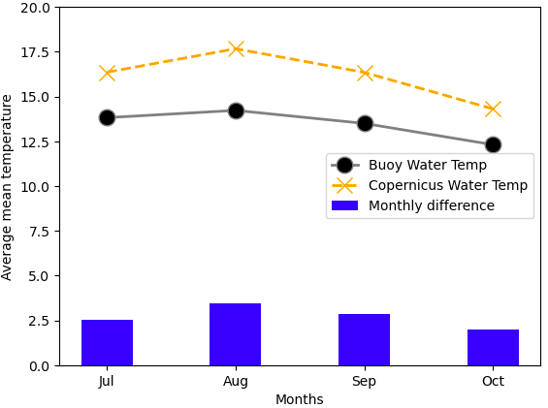
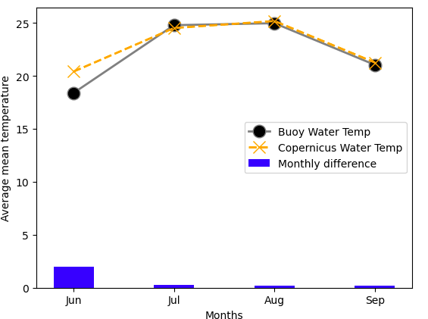
Comparison results by fishery (Copernicus)
Fig. 1. 'Maine': BOG and Copernicus data comparison
Fig. 2. 'Massachusetts': BOG and Copernicus data comparison

Slide 11
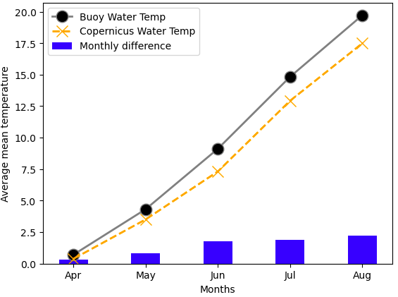
Comparison results by fishery (Copernicus)
Fig. 3. 'New Brunswick/Gulf of St. Lawrence': BOG and Copernicus data comparison
Summary:
Maine (Fig. 1) had the largest temperature discrepancies between Buoy reported data and Copernicus satellites data
Overall, temperature differences between BOG buoy readings and Copernicus satellites data were small

Slide 12
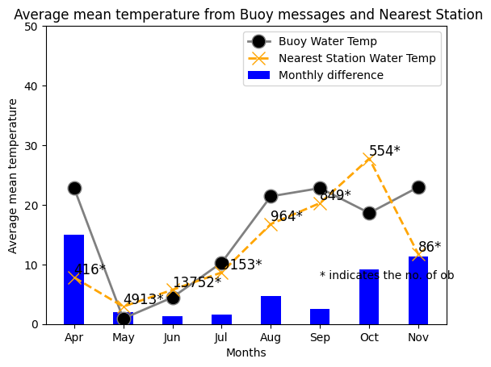
Results: Comparing Canadian weather stations and BOG buoy readings within the same day
Fig. 3. 'Buoy Temperature mean from nearest station': Average mean temperature from Buoy messages and Canadian Station

Slide 13
Caveats of analysis and next steps
Although BOG buoy readings and third-party datasets seemed to be similar in terms of water temperature, we have not run statistical analysis to demonstrate the significance of the differences
Currently we only compared data for 6 months. A longer timeframe may be needed to show whether there are systematic differences in particular months or fisheries
For next steps:
Run regression analysis to identify whether differences are statistically significant
Perform a more detailed analysis to identify potential factors causing minor differences between BOG buoy readings and external datasets

Slide 14
Research Question #2: Location Prediction
Motivation
How buoys typically move (e.g., smallest enclosing circle, by fishery) – Zoey
Highlighted examples of buoys in the dataset that drifted (due to breaking free, or being attached to a different type of fishing gear) - Zoey
Problem of lost/ghost fishing gear and how it affects wildlife
Giving fishermen the ability to recover lost gear more quickly
Methodology
Generating synthetic data using simulations (not enough data in BOG dataset) - Brinda
Pre-processing data for modeling - Brinda for Normalization, Zoey for masking rows, Hazel for transformation
Configuring LSTM model - Brinda
Training model on simulation data - Brinda
Results
Performance of latitude/longitude versus distance/bearing
Ability of model to predict next trajectory of drifting BOG buoy, without further fine-tuning
Caveats of analysis and next steps

Slide 15
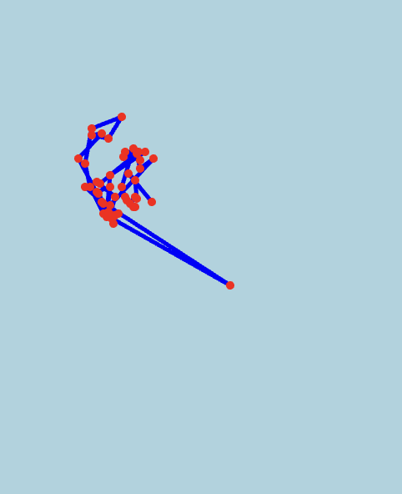
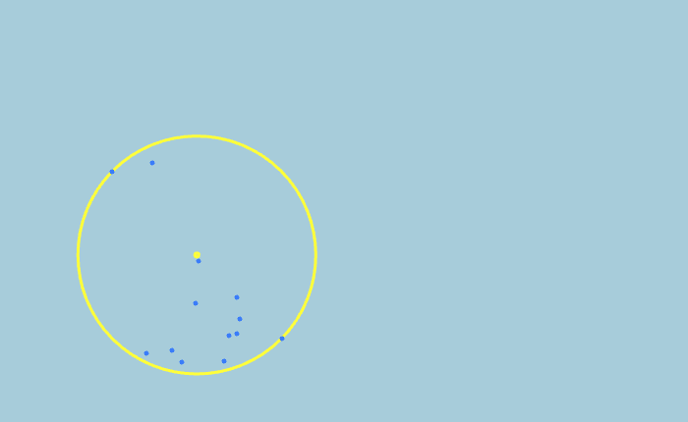
Understanding Buoy Movements
How buoys typically move by fishery v.s. Drifters
Buoys typically move in a circular motion
But sometimes they drift
Notes:
buoys typically move in a circular motion (picture of smallest enclosing circle), but sometimes they drift (picture of BOG drifting trajectory), which causes problems.

Slide 16
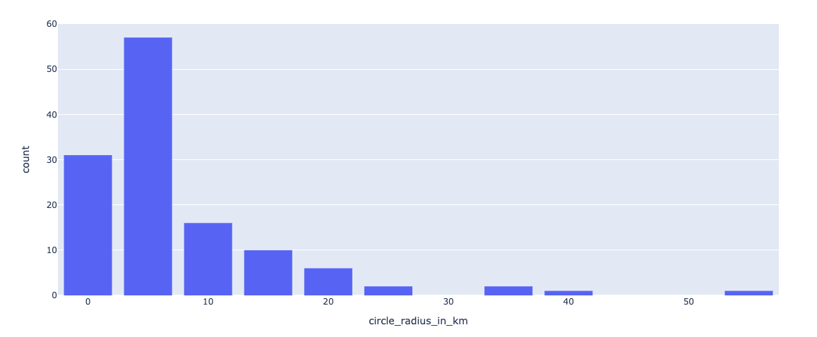
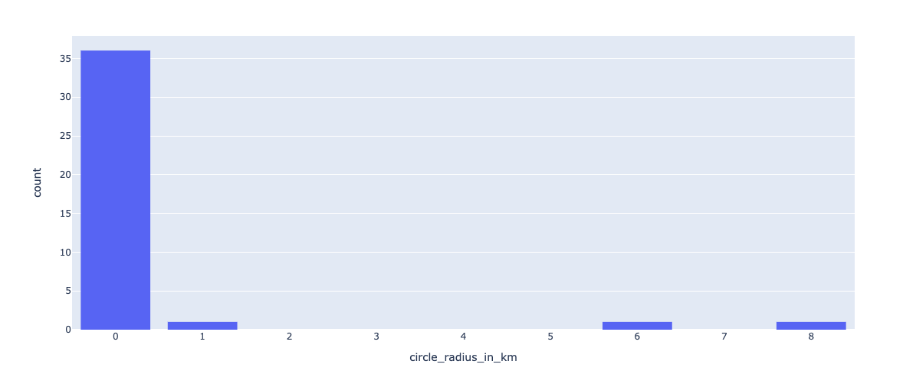
Understanding Buoy Movements
Highlighted examples of buoys in the dataset that drifted (large radius)
Massachusetts
Maine
Notes:
showing the outliers as a histogram, can you plot the buoy measurement readings from one of the outlier deployments on a map and draw lines connecting them? (I.e., Basically showing the drifting buoy's trajectory.) In addition, drifting buoys will have a large radius,

Slide 17
BUOY LOCATION PREDICTION MODEL

Slide 18
Synthetic Data: Why do we need it?
To predict the next location where the buoy would “drift” in the ocean, we need historical data to train the model about the buoy’s past drifting trajectory
It would have been ideal to have years of “trajectory data” for each of our client’s buoys
Trajectory data simply means if we track a given buoy which is deployed in the water over several months, what are the latitude and longitude coordinates that it would drift to, based on the ocean currents and ocean temperature
Trajectory data for the buoys is available only for ~2 years which is insufficient for the machine learning model to learn the pattern of a buoy’s movement
Therefore, we simulate the ocean environment using Copernicus data to artificially increase the number of training samples
Copernicus dataset that was previously discussed is used for the purpose of generating synthetic data which we queried using their service for sea surface current velocities (horizontal/eastward/"U" and vertical/northward/"V") that had been created from oceanic general circulation, wave, and tidal models

Slide 19
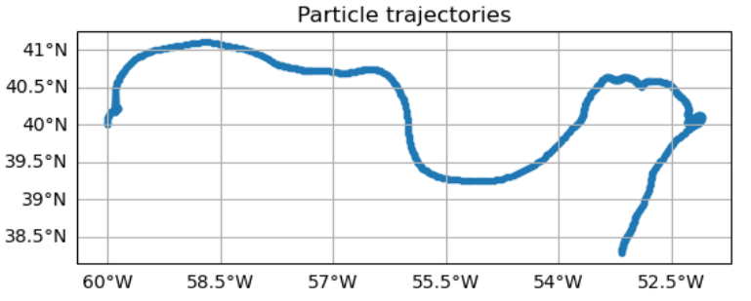
Methodology: Synthetic Data Generation
We use a Python package OceanParcels (MIT license) which simulates the movement of particles in the ocean over time by using ocean current velocities as input data.
We simulate 500 particles in the ocean for every fishery
Each particle is intended to resemble the movement of 1 buoy at different time stamps, thereby generating a particle’s trajectory
A trajectory ID uniquely identifies the multiple locations at which a single particle has “moved” as a result of the ocean’s current velocities and horizontal ocean movement.
The plot shows the trajectory for 1 particle which tells us the location coordinates of the moving particle after every 10 minutes for the next ~550+ timestamps.

Slide 20
Synthetic Data: Methodology
Fieldset Class
A region is generated using NetCDF files where every point in that region is associated with ocean current speeds and specific temperatures
This creates a boundary for the region within which the “synthetically” generated particle will move
Particle Set Class
For each fishery, a list of random latitude-longitude pair coordinates are generated which declare the starting location of a particle being simulated.
We ensure that these lat, lon ranges are bounded by the region in which our client’s fisheries are defined.
Advection Kernel Class
The particle “moves” across the ocean to different locations as a result of the type of movements defined within this class.
How often does the particle move from one location to another? This is defined based on the minimal time difference between deployment readings from our client’s buoy deployment data.

Slide 21
Methodology: Data Pre-Processing
The goal of pre-processing is to streamline the data quality for synthetic data generated from the OceanParcels simulation so it can be used as input for our location prediction model.
Normalization
Features of synthetic data (latitude, longitude and temperature) are scaled using min-max scaling technique such that each feature has values between 0 and 1
Feature Engineering
To transform the time data to the position of the hand of a clock, making it easier for the network to observe trends that depend on the time of day
To convert each latitude/longitude coordinate pair of a buoy to a distance value and a bearing value relative to the coordinate pair of the previous location
4. Standardization
Convert datetime object to timestamp, calculate intervals from starting point to each subsequent timestamp object
Mask all rows of latitude, longitude and temperature (or other variables of interest) with -999 if the datetime does not fall on a specific time interval)
Notes:
Feature Engineering: recent papers have shown this technique to be more accurate and that we wanted to test this alternative feature
Shorten the discussion on preprocessing. I don't think the details are too important but mentioning normalization and our interest in distance/bearing should really be the only things highlighted here

Slide 22
Location Prediction Model
Goal: Predict the “next sequence of locations” where a particles would drift to, given the previous trajectory of a particle
We use a Long Short Term Memory Model
A type of neural network model commonly used for time series data
Especially helpful to use this model when the input to the model is a “sequence” of data points relating to the same entity and the output of the model is also a “sequence” of data points
In our case, we input a particle (i.e. a trajectory ID)
Notes:
SCRIPT

Slide 23
LSTM Model Architecture
We experiment with a 2 layer LSTM model using Keras package in Python
Model Input:
A batch of trajectories with each trajectory consisting of trajectory ID, time, longitude, latitude and temperature upto 100 time steps of historical trajectory data for each of the particles in that batch
Model Output:
For each particle in the batch, the model spits out the next 10 locations where that particle (or the buoy) would drift to
Loss Function:
The function used to define these errors is Mean Squared Error i.e. the model will aim to minimize the mean of squared errors that occur on each particle in the training data

Slide 24
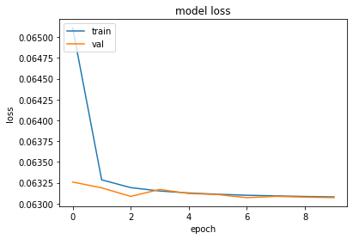
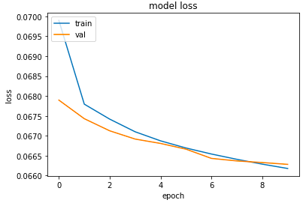
Results - Maine Fishery
Performance of latitude/longitude (loss) v.s. Performance of distance/bearing
latitude/longitude
distance/bearing
Notes:
For Maine, the model is initially incurring large losses. However, starting from the 3rd epoch, the error in prediction reduces significantly for the validation data, which may indicate that the model does not overfit for Maine

Slide 25
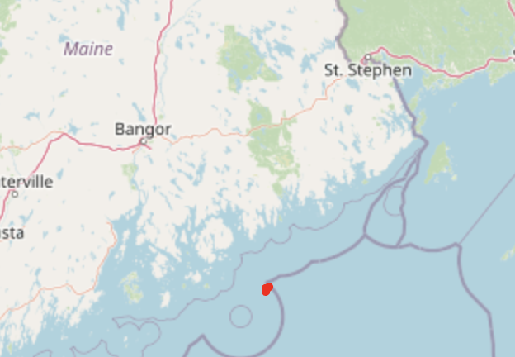
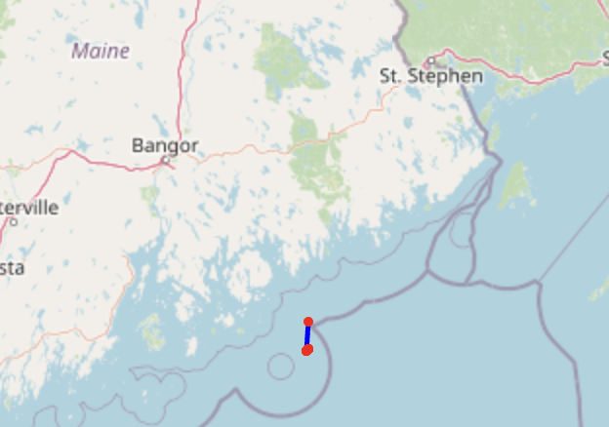
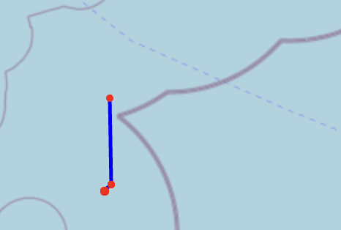
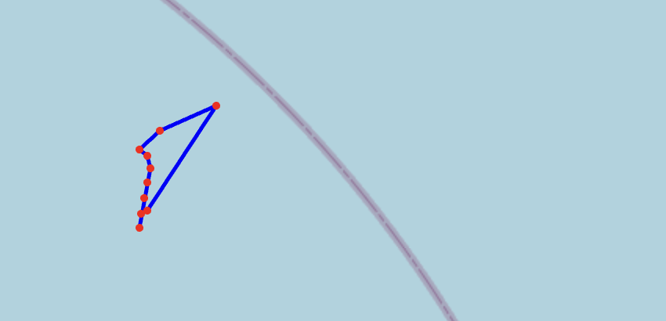
Results - Maine Fishery
Ability of model to predict next trajectory of drifting BOG buoy
Predicted for next 10 steps
Actual trajectory
Notes:
Zoey
The starting point for the latitude and longitude is very similar to the end point in the left plot which shows predicted trajectory of a buoy and in the right plot which shows the actual trajectory of the buoy meaning that the predicted and actual trajectories are pretty close so the model is performing well for the buoys simulated using synthetic data in Maine fishery
Intermediate point, the trajectory changes but at the end it goes back to the same point

Slide 26
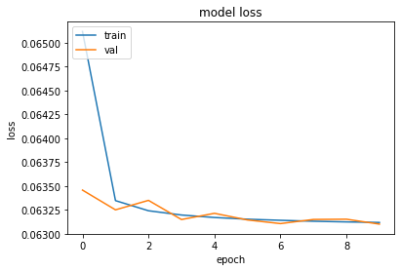
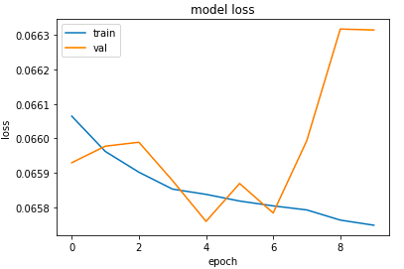
Results - Massachusetts Fishery
Performance of latitude/longitude (loss) v.s. Performance of distance/bearing
latitude/longitude
distance/bearing
Notes:
For Massachusetts, the model does not show overfitting for latitude and longitude
But for distance/bearing, the fact that the training set loss is decreasing while the validation set loss is wildly oscillating suggests that the model is overfit and unable to generalize to new data. It is also possible that the learning rate may be too high. Hyperparameter tuning, increasing the number of epochs, being more careful about our feature selection, and increasing the number of training samples might help

Slide 27
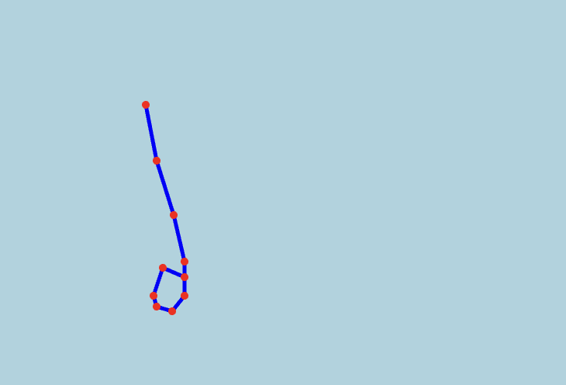
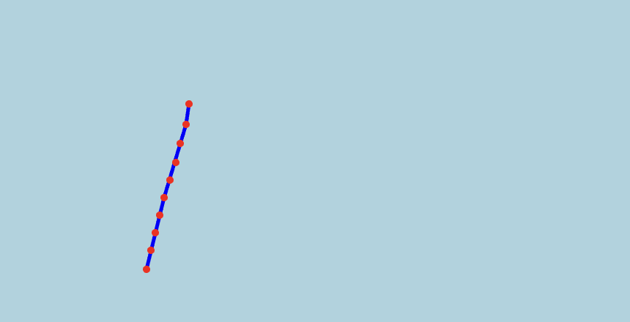
Results - Massachusetts Fishery
Ability of model to predict next trajectory of drifting BOG buoy
Predicted for next 10 steps
Actual trajectory
Notes:
Zoey

Slide 28
Caveats of analysis and next step
Running LSTM model on New Brunswick Fishery
Synthetic Data
How closely the synthetic data will mimic the trajectory of the actual data of buoy trajectories
Time interval (hourly frequency)
Ground-Truthing
It would be an interesting verification to assess whether the model’s prediction are correct
This can be done by comparing real-time information about the actual location of the buoy’s drifting trajectory with the predicted trajectory spit out from the model
Using more unseen data (test set) to evaluate the model
A more accurate way to identify drifters
Anomaly detection

Slide 29
Impact
By analyzing external datasets (i.e., Copernicus satellites & Canadian weather stations), we can establish baseline comparisons for buoys’ temperature sensors. This may serve as a basis for any fine-tuning of the buoys in the future
The fishermen who use Blue Ocean Gear’s smart buoys can track their fishing gear in the ocean so now they will not have to worry about finding the lost buoys as they would have that information on their fingertips with the help of the locations of drifting buoys predicted by LSTM model

Slide 30
Thank you slide
We would like to thank:
Blue Ocean Gear
University of Chicago Data Science Institute
11th Hour Project

Slide 31
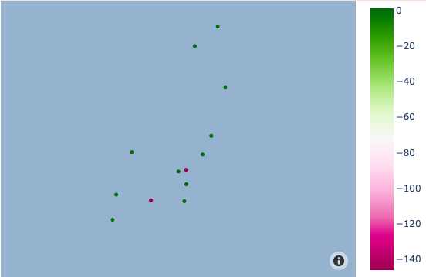
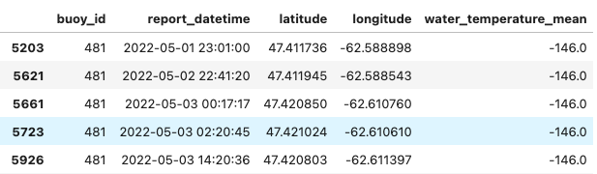
Appendix: BOG outlier examination
Fig. 4. Outlier buoy (id: 481) locations (pink dots)
An example of outlier: Buoy 481
Water_temperature_mean = -146 °C

